Slide 1
Detection of COVID from x-ray images
USING DEEP LEARNING TECHNIQUES

Slide 2
Introduction
The COVID is a deadly disease caused by the newly recognized coronavirus. Official known as Severe Acute Respiratory Syndrome Coronavirus (SARS-COV-2).
At present, COVID disease is increasing daily due to the lack of quick detection methods. All over the world, a huge number of people died of this disease in 2020.
Hence we decided to develop a model to detect Covid from x-rays.
This is an Machine Learning model, which uses Deep Learning techniques like Convolutional Neural Networks.
After developing the model, our idea is to deploy this model into a website, where everyone can access and check their covid 19 status.

Slide 3
Objectives
Since the COVID 19 virus initially affects the lungs of patients, X-ray imaging of the chest is helpful for effective diagnosis.
In this study, an automatic deep learning classification method for detecting COVID-19 from chest X-ray images is suggested using a CNN.
Early prediction of patient severity might assist save hospital resources and reduce the number of patients who die indefinitely.
Currently, X-ray pictures are utilized to detect COVID-19 patients as early signs. In addition, in countries that are unable to purchase laboratory kits for testing, this becomes even more vital. In this study, we aimed to present the use of deep learning for the high-accuracy detection of COVID.

Slide 4
LITERATURE SURVEY
[1].Authors Safynaz Mohammad was proposed a system that is “Applying Different Machine Learning Techniques for Prediction of Covid-19 Severity”, in IEEE Access, vol. 9, pp. 135697- 135707,2021.
In this literature, the proposed system consumes lot of time for the training, because the preprocessing of data is not done which also affects the accuracy.
[2]. J. Ren, R. Ren, M. Green and X. Huang, "Defect Detection from X-Ray Images Using a Three-Stage Deep Learning Algorithm," 2019 IEEE Canadian Conference of Electrical and Computer Engineering (CCECE), 2019, pp. 1-4, doi: 10.1109/CCECE.2019.8861944
In this, the accuracy of the proposed model is less compared to the previous literature.

Slide 5
PROBLEM DEFINITION
The problem that was addressed in proposed project is fast and accurate Artificial Intelligence techniques are needed to assist doctors in their decisions to predict the severity and mortality risk of a patient
A deep pre-trained prediction model was built using CNN.
A clinical study of COVID infected patients has shown that these types of patients are mostly infected from a lung infection after coming in contact with this disease. Chest x-ray (i.e., radiography) and chest CT are a more effective imaging technique for diagnosing lunge related problems.
Deep learning is the most successful technique of machine learning, which provides useful analysis to study a large amount of chest x-ray images that can critically impact on screening of Covid.

Slide 6
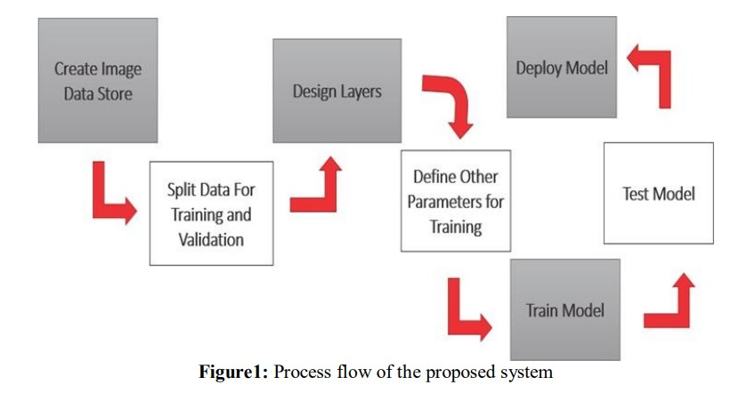
PROCESS

Slide 7
ALGORITHM
Step-1: we have created an image data store and saved the images in two different sub-folders by class name.
In covid sub-folder infected X-ray images will be saved; and in normal sub-folder uninfected X-ray images will be saved.
Step-2: Data Preprocessing - converting the images into gray scale and rescaling the images for the easy computations.
We’ve split the data for training and testing
Step-3: By extracting the features from the data of different x-ray images using different methods like Principle Component Analysis(PCA), we train the CNN for the accurate results.

Slide 8
DATA PREPROCESSING
Grayscale Conversions
ITU-R BT.709 Formula
Convert image to grayscale by using HDTV method.
(0.21*Red +0.72*Green + 0.07*Blue)
Average Color Values
Convert image to grayscale by averaging red, green, and blue color channels.
(Red/3+Green/3+Blue/3)
ITU-R BT.601 Formula
Convert image to grayscale by using PAL/NTSC method.
(0.30*Red +0.59*Green + 0.11*Blue)

Slide 9
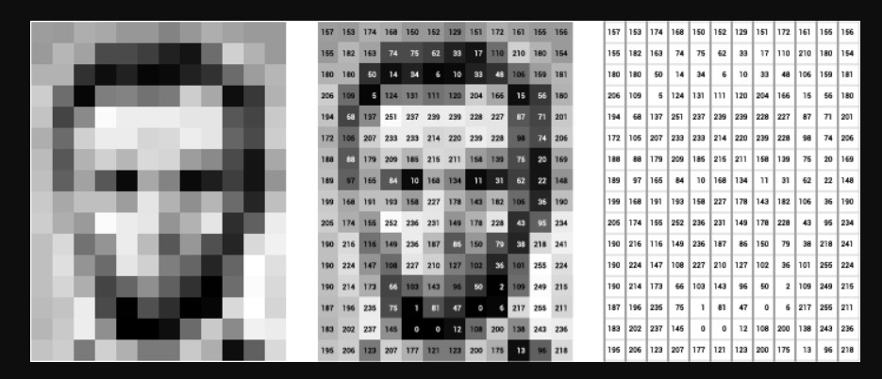

Slide 10
After Grayscaling the image i.e., x rays and ct scans we covert the pixel matrix.
After gray scaling, the images are rescaled to sizes varies from 0-1 by dividing with 255, as pixel size varies from 0-256.
By using Numpy, we create the numpy file which contains the matrices of each image.
This process helps in reducing the consumption of time and made the model to execute very fast.
The time consumption is also based on the amount of data we used to train.
But the more amount of data, the more the accuracy.

Slide 11
CONVOLUTIONAL NEURAL NETWORKS
The CNNs are inspired by visual system of human brain
. CNN is a type of deep neural networks which contain the convolutional, max pooling, and nonlinear activation layers.
Convolution Neural Network has input layer, output layer, many hidden layers and millions of parameters that have the ability to learn complex objects and patterns
Convolution is the process involving combination of two functions that produces the other function as a result. In CNN’s, the input image is subjected to convolution with use of filters that produces a Feature map.
Filters are randomly generated vectors in the network consisting of weights and biases
Many filters can be generated where every filter captures unique feature from input. Filters are also referred as Kernels.

Slide 12
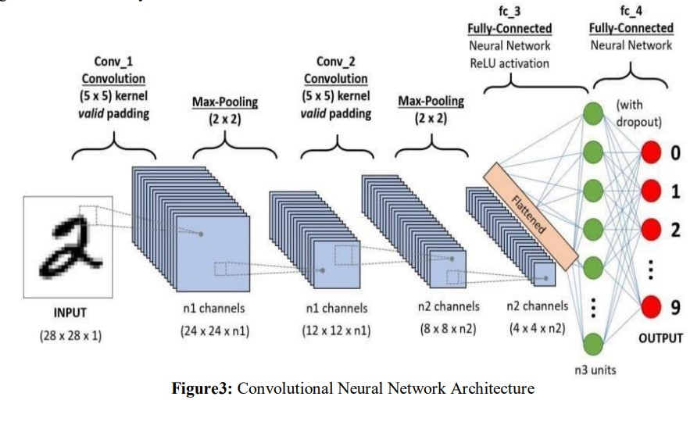

Slide 13
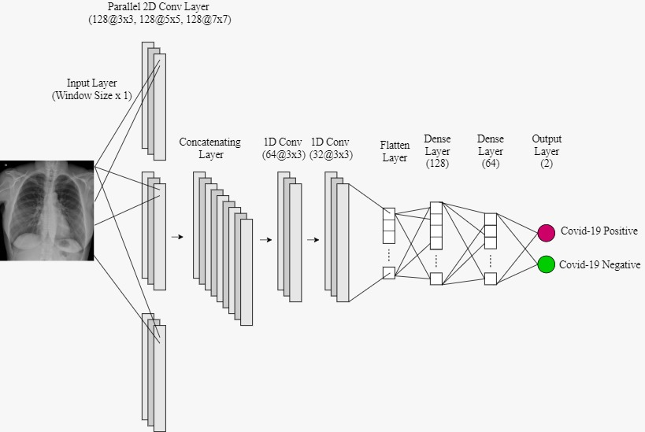

Slide 14
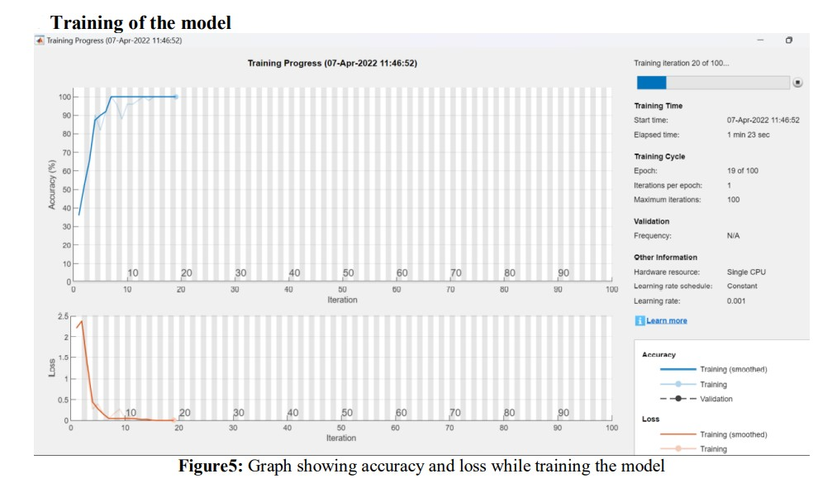
TRAINING OF MODEL

Slide 15
CONCLUSIONS
We have successfully trained a model to classify covid scans, and it depicts the possible scope of applying such techniques in the near future to automate diagnosis tasks.
The accuracy of the created model is increased and the loss function is reduced to make the model more efficient to use.
X-ray pictures are utilized to detect COVID patients as early signs.
In addition, in countries that are unable to purchase laboratory kits for testing, this becomes even more vital
Hence the model for the detection of corona virus traces in lungs can be done by processing the chest x-rays.

Slide 16
REFERENCES
[1]. F. Sayed, A. M. Elkorany and S. Sayed Mohammad, "Applying Different Machine Learning Techniques for Prediction of COVID19 Severity," in IEEE Access, vol. 9, pp. 135697-135707, 2021, doi:10.1109/ACCESS.2021.3116067. https://www.ncbi.nlm.nih.gov/pmc/articles/PMC8545185/
[2].J. Ren, R. Ren, M. Green and X. Huang, "Defect Detection from X-Ray Images Using a Three-Stage Deep Learning Algorithm," 2019 IEEE Canadian Conference of Electrical and Computer Engineering (CCECE), 2019, pp. 1-4, doi: 10.1109/CCECE.2019.8861944
[3].C. Liu et al., "TX-CNN: Detecting tuberculosis in chest X-ray images using convolutional neural network," 2017 IEEE International Conference on Image Processing (ICIP), 2017, pp. 2314-2318, doi: 10.1109/ICIP.2017.8296695
[4].Tanzi L, Vezzetti E, Moreno R, Aprato A, Audisio A, Massè A. Hierarchical fracture classification of proximal femur X-Ray images using a multistage Deep Learning approach. Eur J Radiol. 2020 Dec; 133:109373. doi: 10.1016/j.ejrad.2020.109373. EPub 2020 Oct 23. PMID: 33126175.https://www.ncbi.nlm.nih.gov/pmc/articles/PMC7544769/# ffn_sectitle

Slide 17


